Slide 1
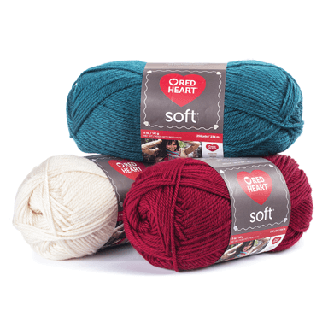
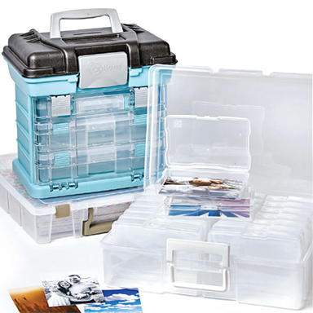
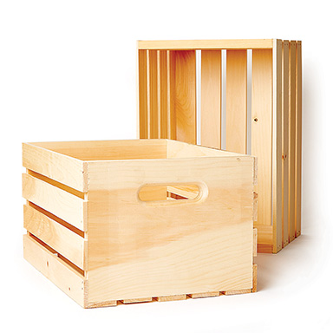

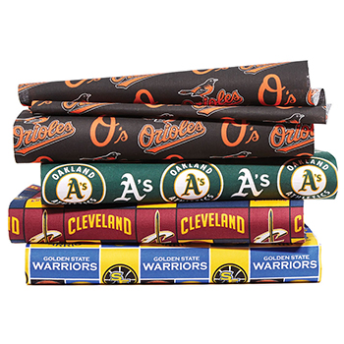
CASE # 2
FABRIC AND CRAFTS STORE

Slide 2
THE ASK:
WHAT SHOULD BE OUR SEGMENT STRATEGY?
Why?
Through What Vehicle(s)?
With what discount rate?
At what product?
DESIGN A TEST AND LEARN PLAN
ESTIMATE FINANCIAL IMPLICATIONS

